Slide 1

BLOCK CODING LEARNER
Session 46
Intent

Slide 2

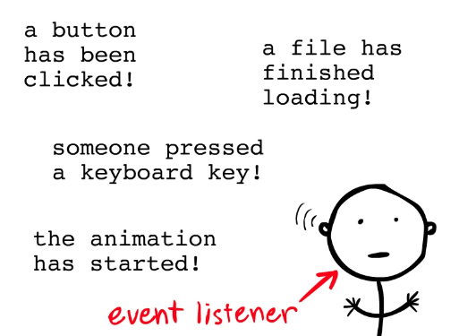
Recall…
What we have learnt in last session
What challenges you are facing

Slide 3

Intent…
We will Learn today:
What is an Intent?
What An Intent Does?
Starting Other Activities Via Intents
Perform a task with Intent

Slide 4
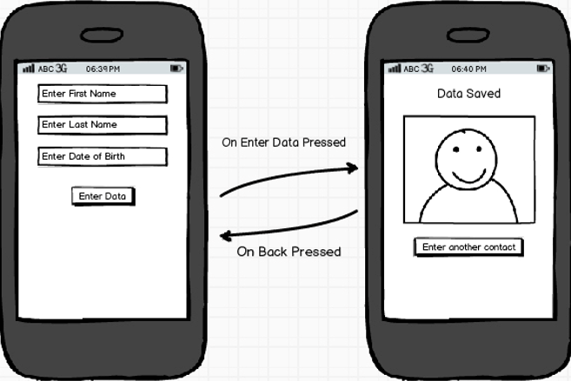
What Is An Intent?
It is a kind of messenger that responds to messages
Intent contains an action carrying some information
Intent is used to communicate between different components

Slide 5
What Is An Intent?
Intent contains an action of carrying some information from one activity to another activity(s)
Activity1
Intent
Activity2
Activity3

Slide 6
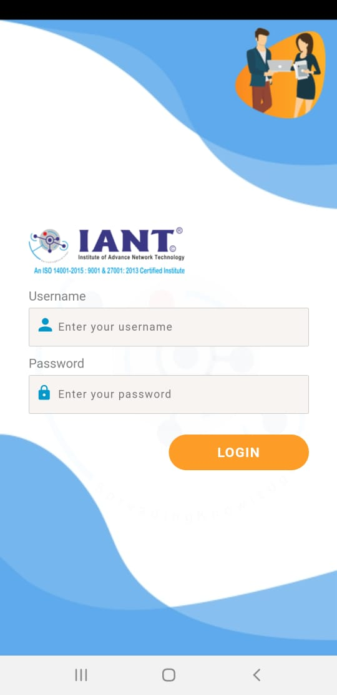
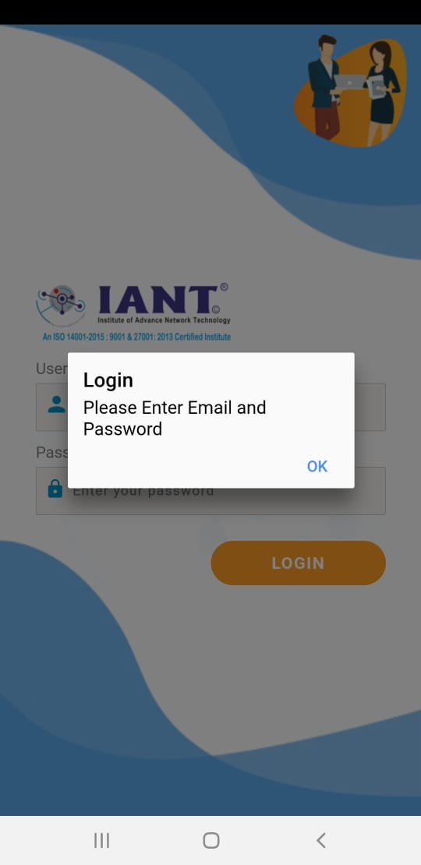
What An Intent Does?
It is used to start a new activity from where ever you are
It is like going to a different screen in an app from one screen
If I click login on the 1st screen without entering data then the second screen will show a message
This service is provided by intent

Slide 7
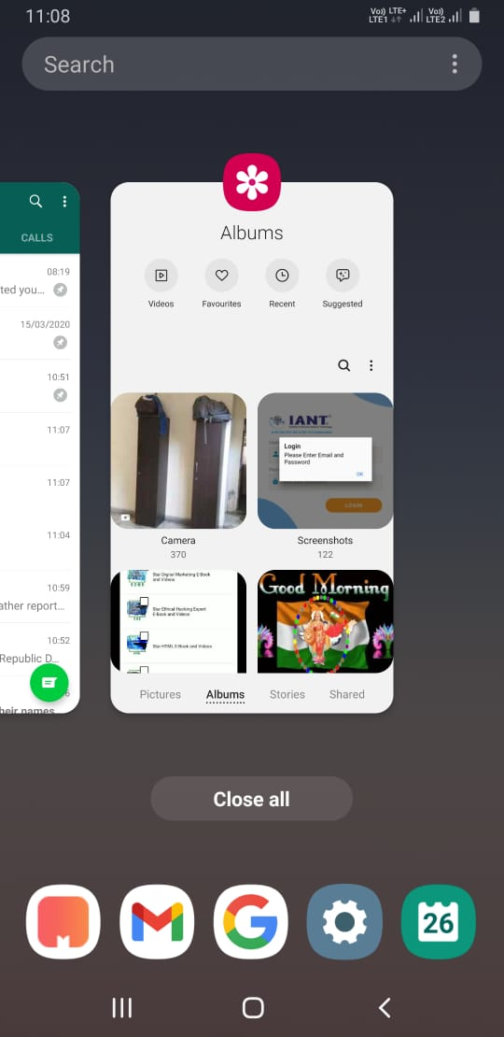
What An Intent Does?
If you want to download something, the download services begin in the background
In case you’re downloading a big file, and you want to play music in the background, intents will start all these services
The image shows the number of services running in background

Slide 8
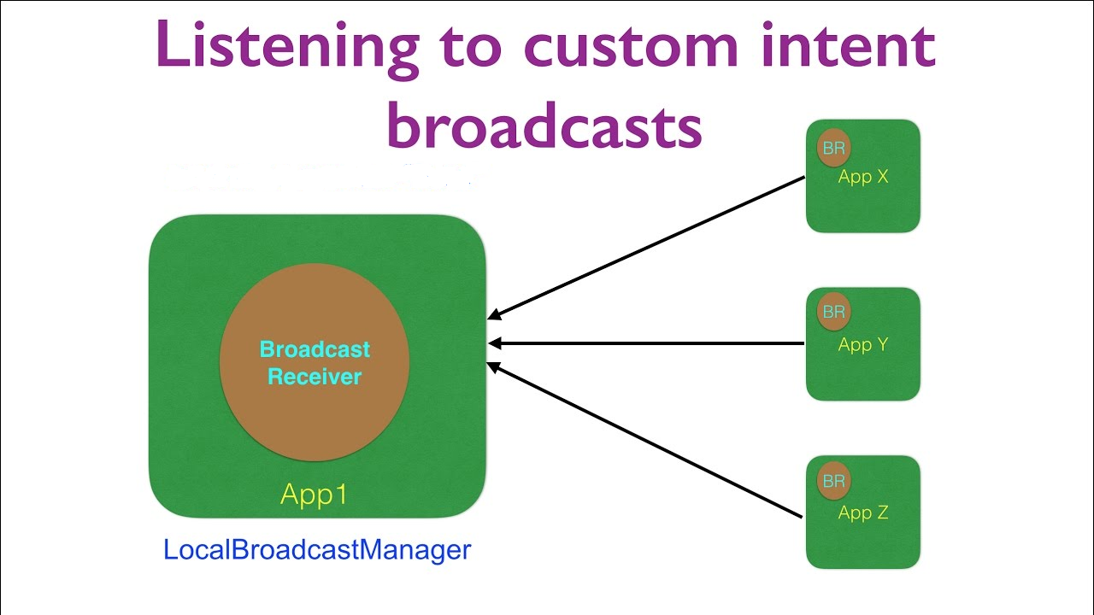
What An Intent Does?
Intents are used to register the broadcast receivers
Intents are also used to tell the system, which is the entry point of your application inside of your application, and which activity should appear in launcher screen

Slide 9
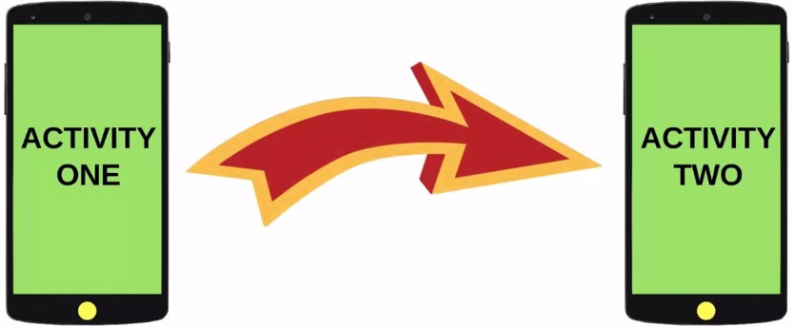
Starting Other Activities Via Intents…
Intents allow you to interact with components from the same applications as well as with components contributed by other applications
For example, an activity can start an external activity for taking a picture

Slide 10
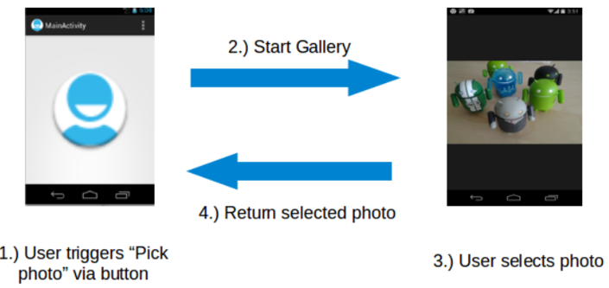
Starting Other Activities Via Intents…
An application can access other app components to achieve a task
For example, from a component of your application you can trigger another component in the system, which manages photos, even if this component is not part of your application

Slide 11
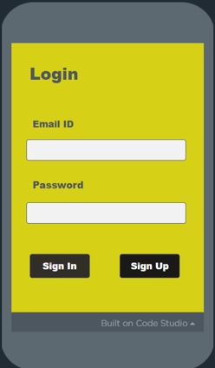
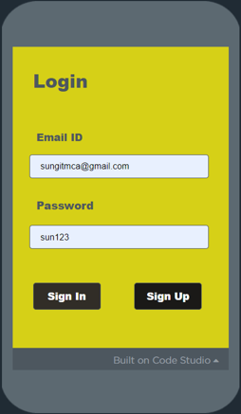
Demonstration…
Secure Login Management System

Slide 12
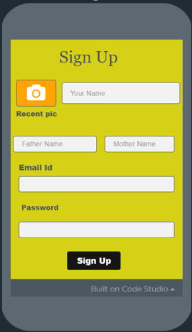
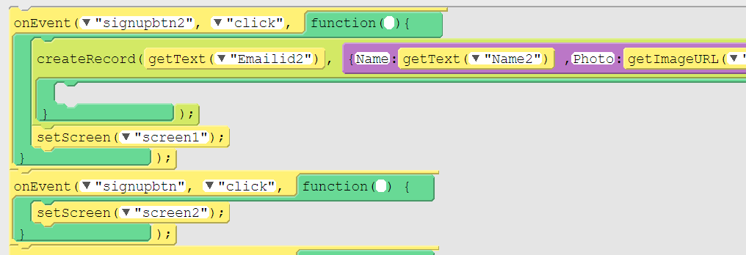
Demonstration…
Sign up screen

Slide 13
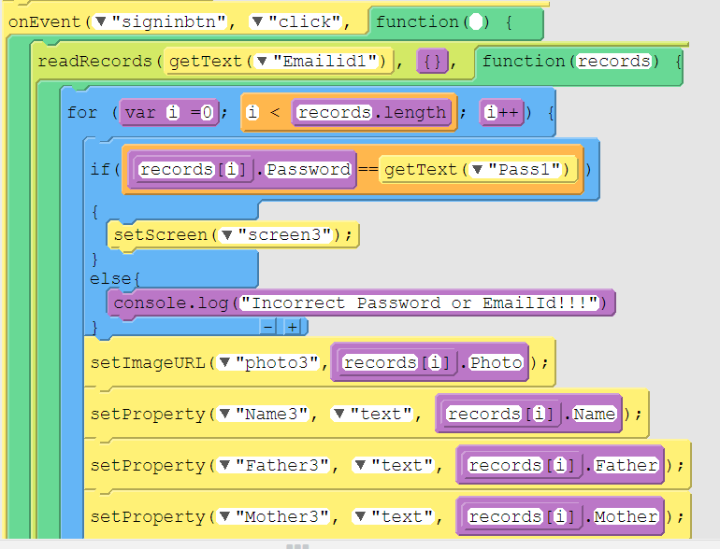
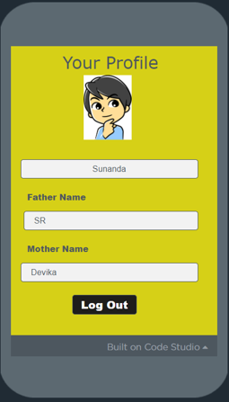
Demonstration…
Your profile screen

Slide 14
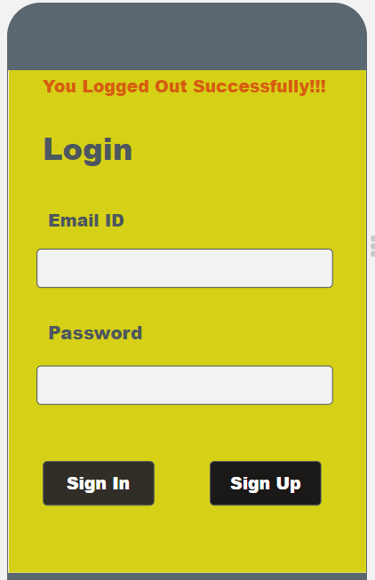
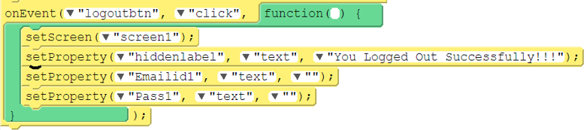
Demonstration…
Logout screen

Slide 15

Summary…
What is an Intent
What An Intent Does?
Starting Other Activities Via Intents

Slide 16

Next Session…
Keyword Mapping:
What is Keyword Mapping?
Learn with happy maps
Coding Logic

